Slide 1
2017 Candidate Petition Training
Butler County Board of Elections June 15, 2017
Notes:
NOTES

Slide 2
Disclaimer:
This course is for general informational purposes only and is not intended to be legal advice or do anything other than assist potential candidates in finding information they need about getting ballot access. Please consult with private legal counsel, the applicable Ohio Revised Code and City charter/ordinances to ensure accuracy.
It is the CANDIDATE, not the Board of Elections, who is responsible for the validity and completion of a petition.
Notes:
NOTES

Slide 3
What does a candidate need to know?
What are the petition requirements (Which petition? Deadline? Filing Fees? Signature requirements?)
The “Do’s and Don’ts” of getting signatures
Canvassing at polling locations on Election Day.
Campaign Finance requirements
Candidate Financial Disclosure (where applicable)
Resource: 2017 Candidate Guide (available on Secretary of State’s website: https://www.sos.state.oh.us)
Notes:
NOTES

Slide 4
Which petition form do I need?
Municipal (except for Hamilton): 3-O
The City of Hamilton has its own special petition form/requirements.
Township: 3-R
County Educational Service Center: 3-W
School Board: 3-T
Where can I get the necessary petition forms?
Butler County Board of Elections “How Do I Run For Office?”
Secretary of State’s Website
Notes:
NOTES

Slide 5
Signature Requirements
All Township offices require a minimum of 25 valid signatures.
All non-city (“local school district”) board of education offices require a minimum of 25 valid signatures.
All other offices: check with the BOE’s 2017 Candidate Requirements Calendar on the website or call the Candidate & Ballot Services Department at (513) 887-3700.
May not submit more than three times the minimum (except in Hamilton, Oxford and Trenton where it is twice the minimum.)
Notes:
NOTES

Slide 6
Filing Fee
City Offices: $45.00
Village Offices: $30.00
Township Offices: $30.00
School Board: $30.00
Pay in either exact change or check payable to the Board of Elections when you file.
Notes:
NOTES

Slide 7
Filing Deadlines
All races except for Mayor or City Council in Hamilton and Middletown:
August 9, 2017
Hamilton Mayor & City Council and Middletown City Council:
August 24, 2017
Regardless of the office, the deadline is 4:00 p.m.
Notes:
NOTES

Slide 8
Brian R. Hester
1802 Princeton Road
Hamilton
45011
Township Trustee
Fairfield
x
Butler
7th
November
2017
15th
March
2017
Brian R. Hester
Notes:
Regardless of petition form, the Statement of Candidacy will require you to list:
Your name (natural derivatives are fine), but no legal titles either before or after (“Dr.” or “Joe Smith, Esq.”)
The address you are registered to vote.
The office you are running for and which jurisdiction
(ex. Trustee/Liberty, School Board/Hamilton)
Whether the term is for a full term (new term) or unexpired term (filling a vacancy). For unexpired terms only, you must also list the date the term ends. No dates need to be listed in 2017 races for full terms.
Date of election (November 7, 2017)
Date you signed and signature.

Slide 9
Petition Committee
Different from campaign finance committee, relates only to your current candidacy.
Committee’s purpose is to notify the Board of Elections of the death of a candidate and, where permitted by law, name a replacement candidate before the election.
Check with the local authority to see if it is required. In most areas, it is entirely optional and can be skipped.
Notes:
NOTES

Slide 10
Nominating Petition
Brian R. Hester
Township Trustee
Fairfield
X
Regardless of petition form, again the requested information from you is the same:
Name
Office you are running for and for which jurisdiction
Full term or unexpired term. For unexpired terms only, you must also list the date the term ends. No dates need to be listed in 2017 races for full terms.
Notes:
NOTES

Slide 11
Overlapping races only
What is an overlapping race?
District includes areas in another county
Examples: Middletown, Monroe, College Corner
Collect signatures from voters in different counties on separate petition forms
What if I have signers from more than one county on the same petition form?
County with the most signatures on that form will process
Signatures from other counties will not be valid
Example: Petition has 10 signatures from Warren County and 6 from Butler County. Warren County will check the 10 signatures, and then the rest will be invalid.
Notes:
NOTES

Slide 12
Who can sign your petition?
Registered voters in your district
Address on petition must match voter registration
Unsure if they are registered?
Carry voter registration forms with you and have them complete when signing (BOE can supply these)
OR, register them online at http://myohiovote.com
We will process any voter registration forms you submit before we check your petition’s signatures.
Notes:
NOTES

Slide 13
How should voters sign?
Voters should:
Sign in ink, not pencil (no ink stamps).
Use their cursive, legal mark
The signature should roughly match the one they used when signing for a Driver’s License or voter registration.
Write the address where they live, not a P.O. Box or mailing address
Write the date of signing
Can use ditto marks (“ “) if information is the same as signature immediately above it.
Notes:
NOTES

Slide 14
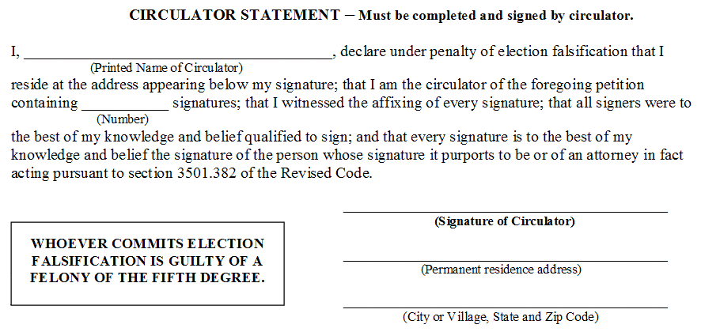
After collecting signatures
Whoever circulated your petition must complete Circulator Statement.
Brian Hester
18
Brian Hester
1802 Princeton Rd.
Hamilton, OH 45011
Notes:
NOTES

Slide 15
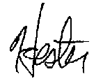
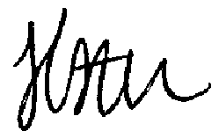
Easiest way to invalidate a part-petition
Circulator going door-to-door is told by a husband that his wife will sign but can’t come to the door. He disappears with part-petition into the house and returns it like this:
But here’s how their signatures appear on file at the BOE:
Result?
Not only is the wife’s signature invalid, but the entire part-petition is invalidated, along with the other signatures because the circulator clearly allowed someone else to sign for another or otherwise did not witness every signature.
Notes:
NOTES

Slide 16
Easiest way to avoid invalidation
Circulator going door-to-door is told by a husband his wife will sign but can’t come to the door. He disappears with part-petition into the house and returns it like this:
But here’s how their signatures appear on file at the BOE:
How do you avoid invalidation?
Circulator simply strikes out any signature she or he didn’t witness (the wife’s on line 2). Husband’s signature is valid, and circulator doesn’t include the struck out signature in the signature count in their circulator statement. Petition is valid.
Notes:
NOTES

Slide 17
More “Do’s” and “Don’ts”
Do
Don’t
Get at least twice the minimum number of signatures required.
Let a circulator sign a petition form that another circulator is circulating.
Make sure the house number and address of the signer is legible.
Try to file in enough time before the deadline that you can start over again if need be.
Submit just minimum number of signatures required.
Sign your own petition.
Let a circulator sign a petition form they’re circulating.
Worry if the signature is legible.
Let anyone sign the petition for someone else or without your circulator witnessing it.
Wait to file until the deadline.
Notes:
NOTES

Slide 18
Additional Reference & Guidance:
Be sure to consult the General Rules Governing Petitions handout.
Each of the topics we just covered are referenced there.
Be sure to review it with anyone circulating your petition beforehand.
Notes:
NOTES

Slide 19
City of Hamilton & Oxford candidates
No voter should sign more petitions for an office than shall be elected.
Regardless of how many potential candidates there are:
A Hamilton voter in 2017 can’t sign more than 3 candidates’ petitions for city council.
An Oxford voter in 2017 can’t sign more than 4 candidates’ petitions for city council.
If a voter signs more, the order in which petitions are filed will determine which signatures will count.
So, if a Hamilton voter signs four or more petitions, it will count on the first three filed and be invalid on all others.
Notes:
NOTES

Slide 20
City of Hamilton Candidates Only
For Mayor and City Council (not including Hamilton City Schools Board of Education)
Notes:
NOTES

Slide 21
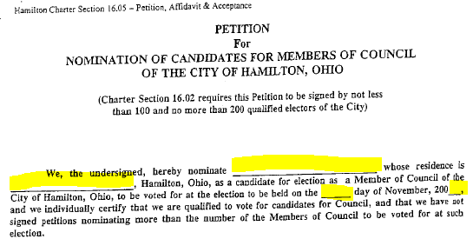
Special Rules for City of Hamilton
Must Use A Different Petition Form
Minimum signature requirement is 100, and maximum is 200.
Instead of a Statement of Candidacy, you complete the Nomination of Candidate:
Brian Hester
1802 Princeton Rd.
7th
17
Notes:
NOTES

Slide 22
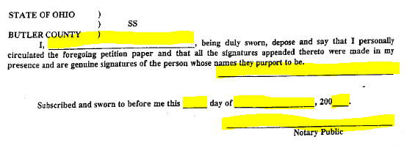
Special Rules for City of Hamilton
Instead of a Circulator’s Statement, the Circulator must sign an affidavit and have it notarized before filing:
Brian Hester
Brian Hester
31st
July
17
John Smith
Notes:
NOTES

Slide 23
Special Rules for City of Hamilton
After the Circulator’s Affidavit is notarized, the candidate then must sign and date this section before filing:
Brian Hester
1802 Princeton Rd.
31st
July
17
Brian Hester
Notes:
NOTES

Slide 24
Pre-Checking Petitions before Filing
How to ensure your petition will be certified on the first try.
Notes:
NOTES

Slide 25
Checking your petitions before filing
Use the Butler County Petition Filing Checklist
Use the computers in the BOE Lobby to check that your signers’ are registered to vote and their signature matches the signature on file.
BOE staff will show you how to search using the same program used to validate petitions.
Count your petition forms and total your signatures to ensure the total signatures are not over the maximum limit.
Notes:
NOTES

Slide 26
And if something is wrong?
Per the Secretary of State, the BOE cannot pre-check your petitions, but we can answer any questions you may have.
If you’ve already filed, you can withdraw your petition and (time permitting) circulate and file a new petition.
Notes:
NOTES

Slide 27
Election Day! Canvassing the polls
What a candidate and campaign volunteers can and cannot do at the polls on Election Day

Slide 28
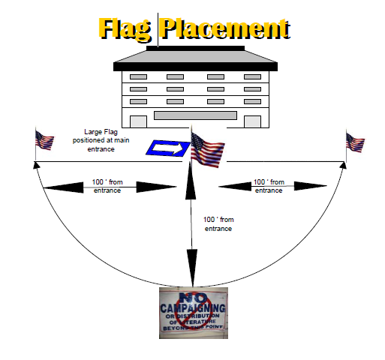
Campaigning at Polling Location
U.S. flags outside on the front, left and right side of the polling place entrance mark the boundary arc where candidates/volunteers cannot campaign.

Slide 29
Election Day Campaigning
Candidates/volunteers cannot talk to voters/hand out literature within buffer zone.
Follow any instructions by a polling official on site.
The candidate/campaign may go into a polling place at 11 am and 4 p.m. to inspect a report of voters who have cast ballots at that location.
Any person who enters a polling location for any reason, no matter how brief, must either remove or otherwise cover any campaign-related materials, including shirts, hats, buttons, stickers, etc.

Slide 30
Campaign Finance 101
The Basics of Campaign Finance for Local Offices
Notes:
NOTES

Slide 31
Campaign Finance Ground Rules
You cannot receive or spend any money on your race (except your filing fee) even out of your own pocket without first setting up a campaign finance committee with the Board of Elections.
To set up a campaign committee, file a Designation of Treasurer (DOT) (Form 30-D on the Ohio Secretary of State’s Campaign Finance website or on our website) with the BOE
Must be signed by the candidate and treasurer and provides a committee name, mailing address and other contact information.
Notes:
NOTES

Slide 32
Campaign Finance Ground Rules
Once you file your Designation of Treasurer Form, we will mail your treasurer reminders of upcoming filing deadlines at least ten days out.
After you file your petition, you will receive a packet of campaign finance information that will provide common forms you’ll need to file, a calendar of filing deadlines, and relevant sections to the Ohio Secretary of State’s Campaign Finance Handbook for your review and reference.
Notes:
NOTES

Slide 33
Campaign Finance Ground Rules
If you raise or spend over $1,000 by October 18th, you must file a pre-general campaign finance report by 4 p.m. on Oct. 26th. Otherwise, filing the pre-general report is optional.
All candidates on the ballot who have filed a Designation of Treasurer must file the 2017 Post-General campaign finance report by 4 p.m. on December 15th.
Reports all activity since the last report (if one was filed) through Dec. 8th, OR
Reports all activity since committee opened (if no other report was filed) through Dec. 8th.
Notes:
NOTES

Slide 34
Campaign Finance Ground Rules
Failure to comply with these requirements can result in an investigation by the Ohio Elections Commission and civil fines (up to $100 a day per day for failing to file until filed) and even the denial of issuance of your certificate of election if you win.
Notes:
NOTES

Slide 35
Financial Disclosure
Ohio Ethics Commission
Notes:
NOTES

Slide 36
Financial Disclosure
Different from campaign finance, this focuses on the personal income, investments, and debts of the candidate.
Electronically filed with the Ohio Ethics Commission.
Only the following types of offices have to file a financial disclosure:
City Mayor/City Council
Butler County Educational Service Center
Lakota Local Schools Board of Education
Deadline to file is May 15th if you already serve in an office in which you are required to file. Otherwise, you must file by October 10th.
Any questions should be directed to the Ohio Ethics Commission at (614) 466-7090.
Notes:
NOTES

Slide 37
Campaign Resources
How else Candidate & Ballot Services can assist your campaign

Slide 38
Helpful Campaign Info
Available on Board of Elections website:
Precinct Maps
Walking Lists (can be filtered by district, party, etc.)
Absentee Ballot Mailing Label Information
Prior Election Results with precinct level turnout information.
Available as Public Record requests:
List of voters in your district by household
List of voters in your district filtered by those who voted in either of the last two municipal elections (2013 and 2015)
Reports can be in .pdf or Excel and are free if electronically sent.
Large color maps of your districts ($12 charge)
Notes:
NOTES

Slide 39
Any questions?
Thanks for coming!
Notes:
NOTES

